Slide 1
EKF-SLAM Monte Carlo Localization
Reza Ghabcheloo
IHA 4306 Moro

Slide 2
Content
Data association
Simultaneous Localization and Mapping (SLAM); focus EKF-SLAM
Monte Carlo Localization (MCL)
Ref:
Principles of Robot Motion: Theory, Algorithms, and Implementation
by Howie Choset et al.
Intro to Autonomous Mobile Robots, R. Siegwart et al

Slide 3
Question, localization
Q. We have an omni-directional robot moving on a line on a plane. Odomtery uncertainties are the same in all the x, y, heading. If we measure distance to a wall, plot the localization uncertainty progress.

Slide 4
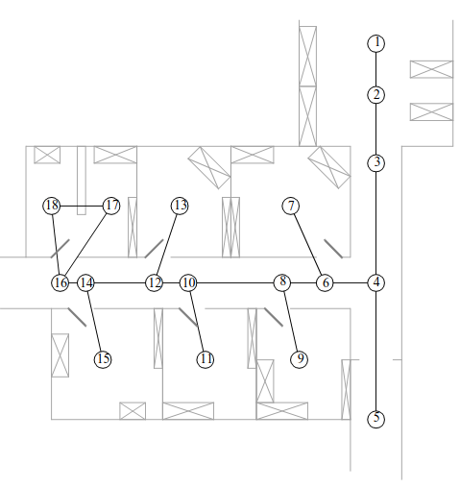
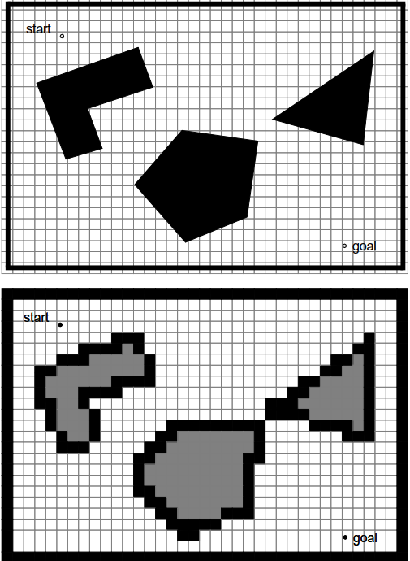
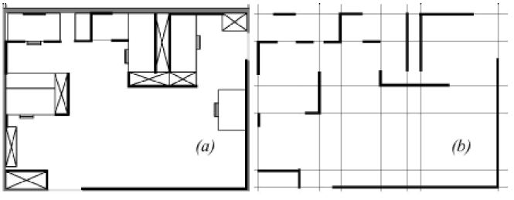
Map
A topological representation →
Significant places of the environment (discrete state space)
Metric representation:
Fine grid (10-30cm, 2-10deg)
Features (continuous state space)

Slide 5
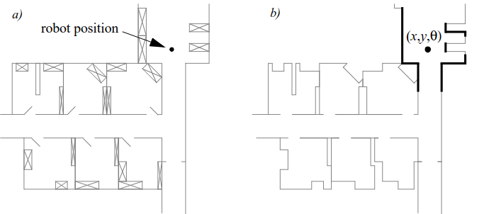
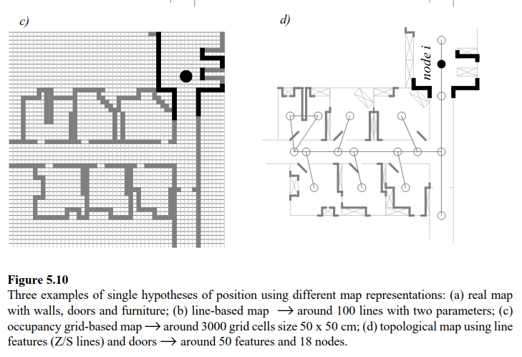
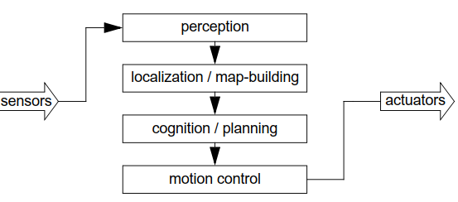
Examples from Siegwart

Slide 6
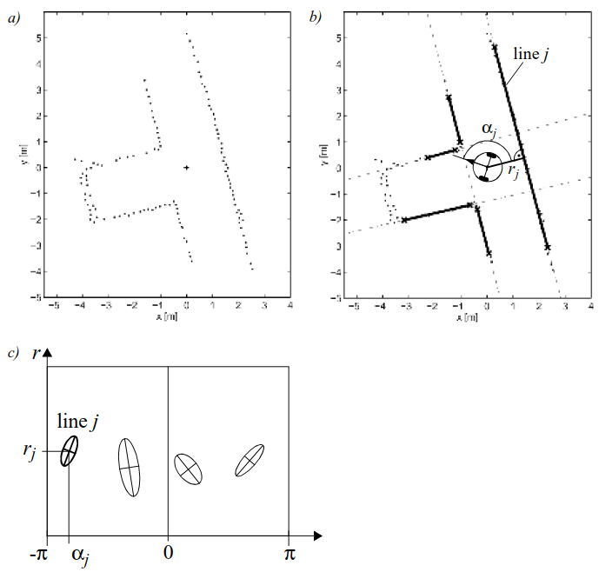
Feature / landmark
Raw sensor data
Feature extraction
Uncertainty models

Slide 7
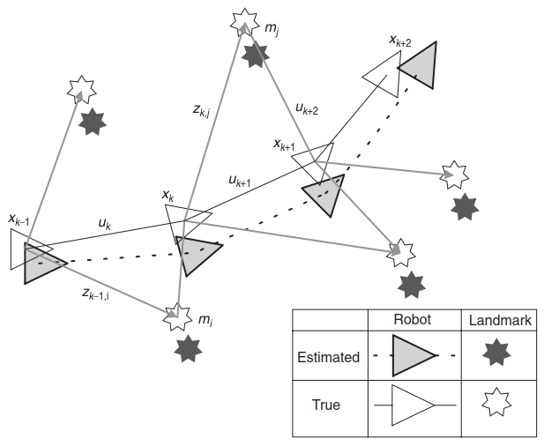
SLAM

Slide 8
Data association

Slide 9
Data Association
Localization: In practice, landmarks have similar properties which make them good features but often make them difficult to distinguish one from another. When this happens, we must address the problem of data association, which is the question of which landmark corresponds to a particular measurement. Mahalanobis norm: the fittest landmark
SLAM: We must determine which landmark corresponds to each measurement. We also have to determine when a new landmark has been encountered. Adding features to the map as they arrive / become visible

Slide 10
Data association, algorithm
Find the most fit feature from the map
Use the feature for localization
EKF review…

Slide 11
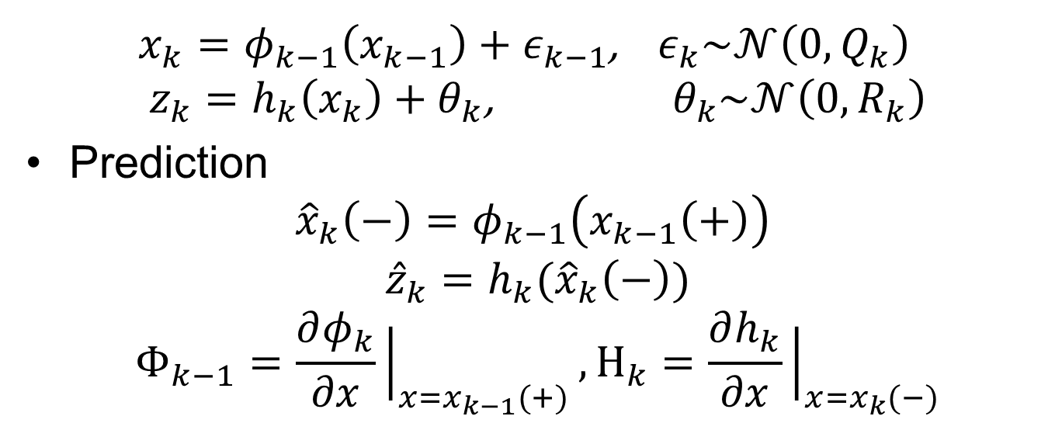
EKF: nonlinear filter 1/3
$x_{k}=φ_{k−1}\left(x_{k−1}\right)+ε_{k−1}$, $ε_{k}\sim 𝒩\left(0,Q_{k}\right)$
$$z_{k}=h_{k}\left(x_{k}\right)+θ_{k}\text{,} θ_{k}\sim 𝒩\left(0,R_{k}\right)$$
Prediction
$${\hat{x}}_{k}\left(−\right)=φ_{k−1}\left(x_{k−1}\left(+\right)\right)$$
$${\hat{z}}_{k}=h_{k}({\hat{x}}_{k}\left(−\right))$$
$$Φ_{k−1}=\frac{∂φ_{k}}{∂x}{\left.​\right|}_{x=x_{k−1}(+)},H_{k}=\frac{∂h_{k}}{∂x}{\left.​\right|}_{x=x_{k}(−)}$$
Expected measurement
With known landmarks

Slide 12
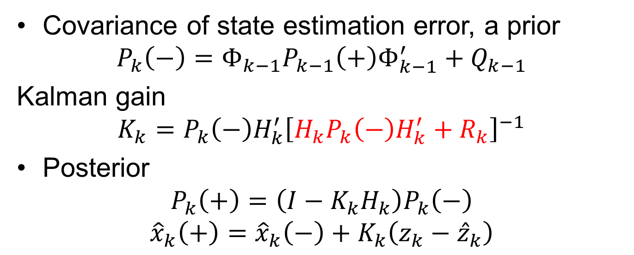
EKF: nonlinear filter 2/3
Covariance of state estimation error, a prior
$$P_{k}\left(−\right)=Φ_{k−1}P_{k−1}\left(+\right)Φ_{k−1}^{′}+Q_{k−1}$$
Kalman gain
$$K_{k}=P_{k}\left(−\right)H_{k}^{′}{\left[H_{k}P_{k}\left(−\right)H_{k}^{′}+R_{k}\right]}^{−1}$$
Posterior
$$P_{k}\left(+\right)=\left(I−K_{k}H_{k}\right)P_{k}\left(−\right)$$
$${\hat{x}}_{k}\left(+\right)={\hat{x}}_{k}\left(−\right)+K_{k}\left(z_{k}−{\hat{z}}_{k}\right)$$
Covariance of innovation

Slide 13
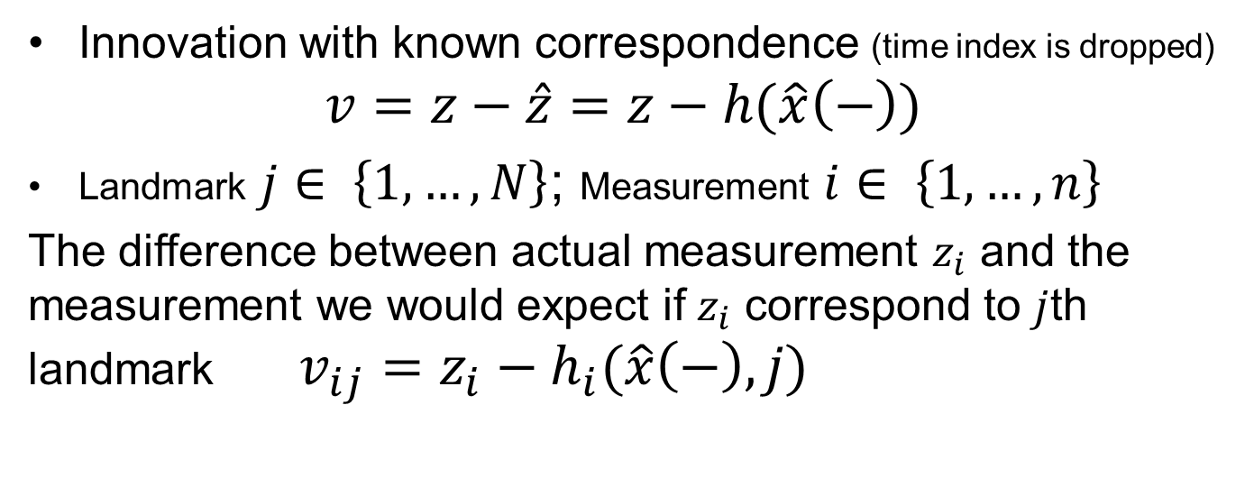
Find the most fit feature from the map
Innovation with known correspondence (time index is dropped)
$$v=z−\hat{z}=z−h(\hat{x}\left(−\right))$$
Landmark $j∈ \left\{1,…,N\right\}$; Measurement $i∈ \left\{1,…,n\right\}$
The difference between actual measurement $z_{i}$ and the measurement we would expect if $z_{i}$ correspond to $j$th landmark $v_{ij}=z_{i}−h_{i}(\hat{x}\left(−\right),j)$

Slide 14
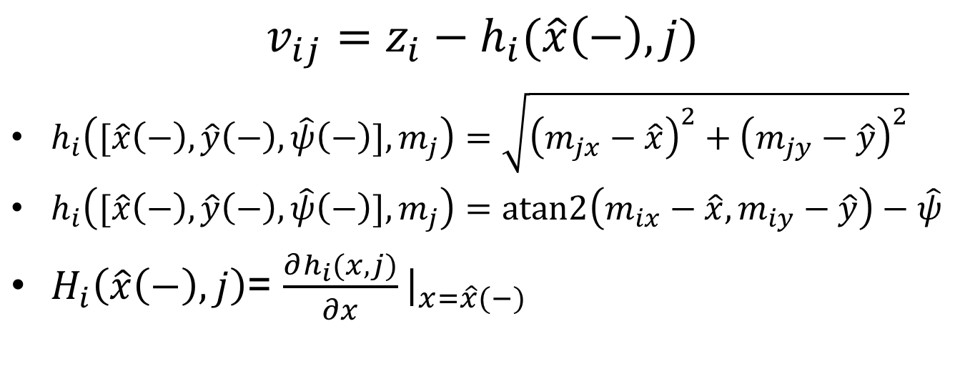
Example
$$v_{ij}=z_{i}−h_{i}(\hat{x}\left(−\right),j)$$
$h_{i}\left([\hat{x}\left(−\right),\hat{y}\left(−\right),\hat{ψ}\left(−\right)],m_{j}\right)=\sqrt{{\left(m_{jx}−\hat{x}\right)}^{2}+{\left(m_{jy}−\hat{y}\right)}^{2}}$
$h_{i}\left([\hat{x}\left(−\right),\hat{y}\left(−\right),\hat{ψ}\left(−\right)],m_{j}\right)=atan2\left(m_{ix}−\hat{x},m_{iy}−\hat{y}\right)−\hat{ψ}$
$H_{i}\left(\hat{x}\left(−\right),j\right)$= $\frac{∂h_{i}(x,j)}{∂x}{\left.​\right|}_{x=\hat{x}(−)}$

Slide 15
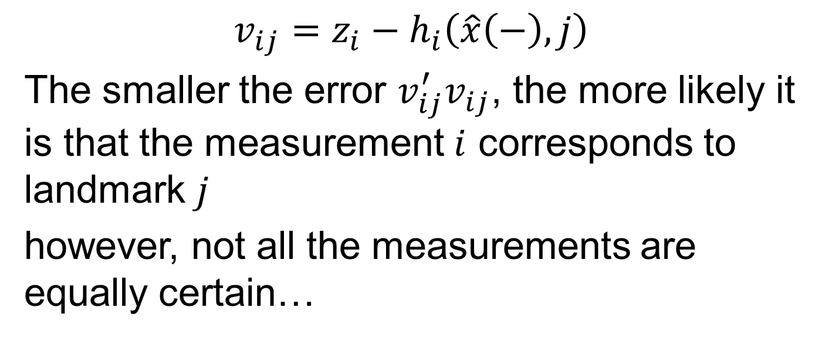
Data association
$$v_{ij}=z_{i}−h_{i}\left(\hat{x}\left(−\right),j\right)$$
The smaller the error $v_{ij}^{′}v_{ij}$, the more likely it is that the measurement $i$ corresponds to landmark $j$
however, not all the measurements are equally certain…

Slide 16
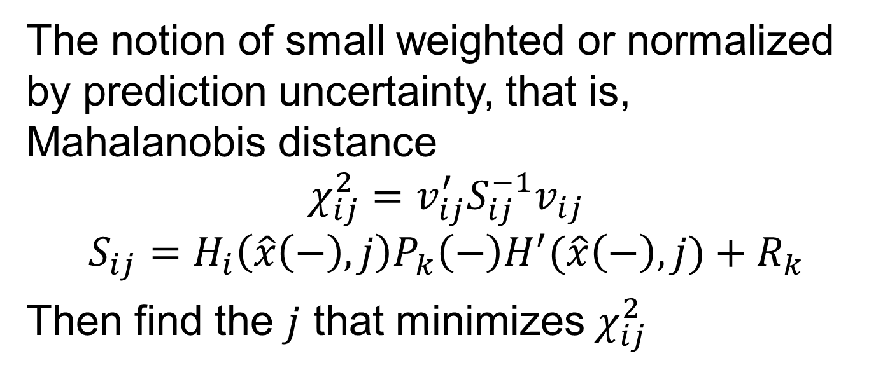
Using Mahalanobis distance
The notion of small weighted or normalized by prediction uncertainty, that is, Mahalanobis distance
$$χ_{ij}^{2}=v_{ij}^{′}S_{ij}^{−1}v_{ij}$$
$$S_{ij}=H_{i}\left(\hat{x}\left(−\right),j\right)P_{k}\left(−\right)H^{′}(\hat{x}\left(−\right),j)+R_{k}$$
Then find the $j$ that minimizes $χ_{ij}^{2}$

Slide 17
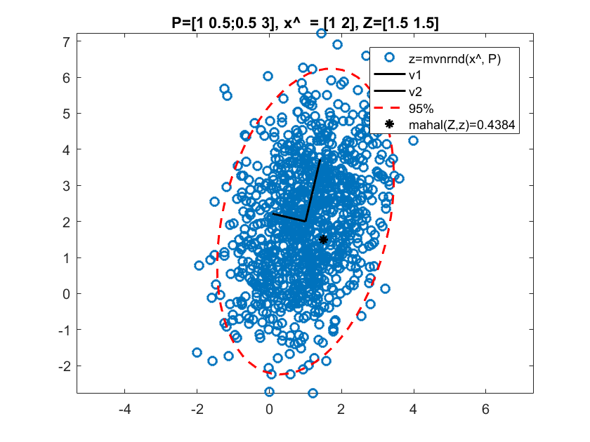

Mahalanobis distance
Mahalanobis distance indicates how far away the point $x$ is from the mean $\hat{x}$ in units of standard deviation
$d_{P}(x,\hat{x}$)=${\left\|x−\hat{x}\right\|}_{P}^{2}={\left(x−\hat{x}\right)}^{T}P^{−1}(x−\hat{x})$
where $P$ is the covariance matrix
Matlab
mvnrnd(.)
mahal(.)
Note: ${\left\|Z−\hat{x}\right\|}_{P}^{2}$=0.4545

Slide 18
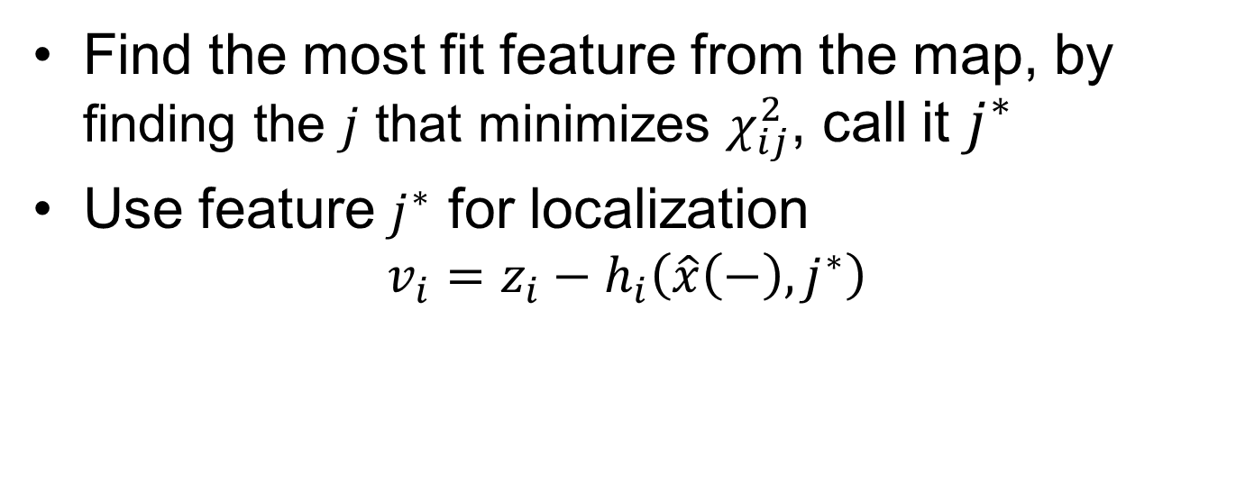
Data association, summary
Find the most fit feature from the map, by finding the $j$ that minimizes $χ_{ij}^{2}$, call it $j^{∗}$
Use feature $j^{∗}$ for localization
$$v_{i}=z_{i}−h_{i}\left(\hat{x}\left(−\right),j^{∗}\right)$$

Slide 19
EKF SLAM

Slide 20
SLAM
Build a map and localize yourself in that map concurrently
In this lecture:
online EKF SLAM

Slide 21
Maps for planning and obstacle avoidance
Landmark maps not useful for planning
A common approach is two stage solution: Perform
SLAM to build a landmark map; then
Occupancy grid map with know pose

Slide 22
Maps for planning and obstacle avoidance
One common solution is to build a feature map (SLAM) and then knowing the pose build an “occupancy grid map with know pose”
Occupancy grid map
Feature map

Slide 23
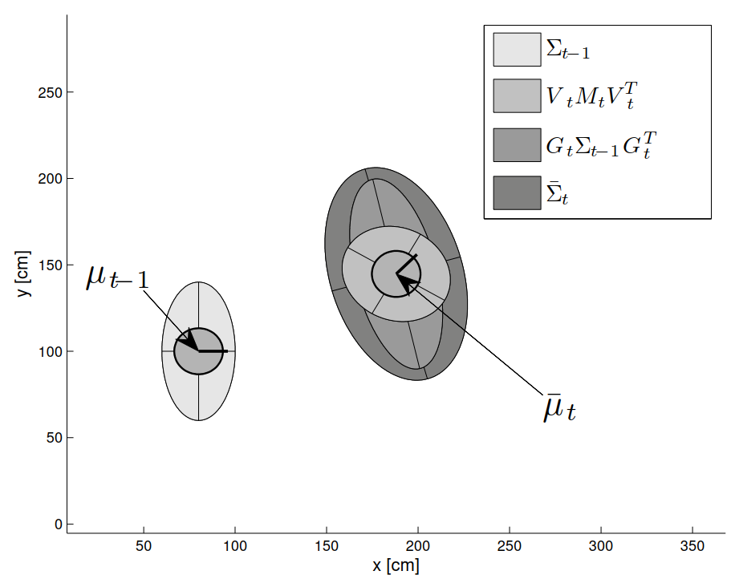
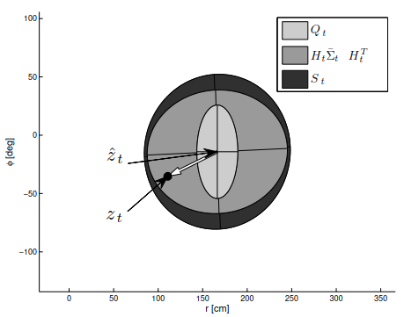
EKF, review
Uncertainties are unimodal: ellipsoids

Slide 24
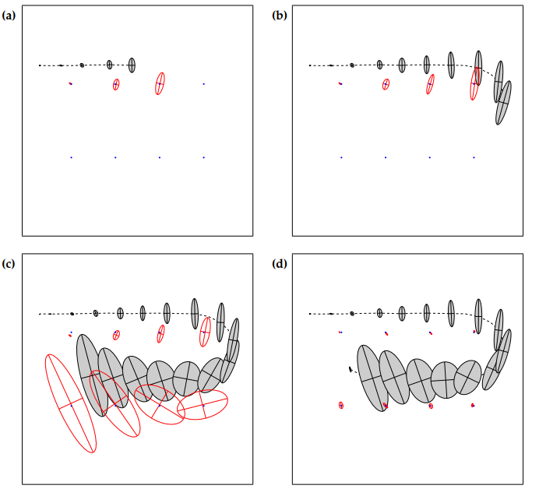
EKF SLAM
Blue dots are landmarks (initially unknown)
Dash line: robot path
Gray: robot pose belief
Red: landmarks position belief
Uncertainty of all the landmarks and the robot pose is reduced, as soon as the first landmark is revisited!

Slide 25
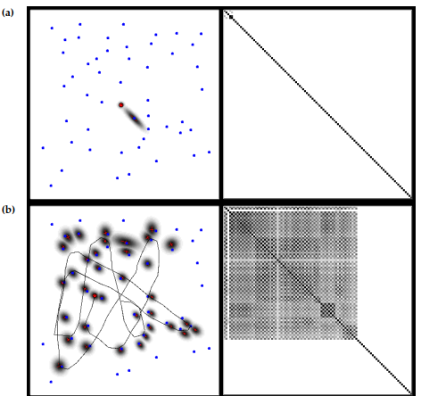
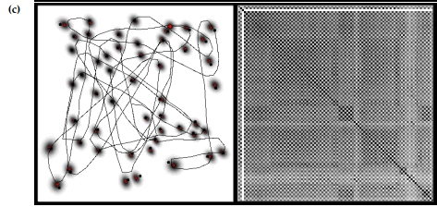
EKF SLAM
Left column: the robot and the landmarks
Right column : covariance matrix
After a while all the landmark locations become correlated

Slide 26
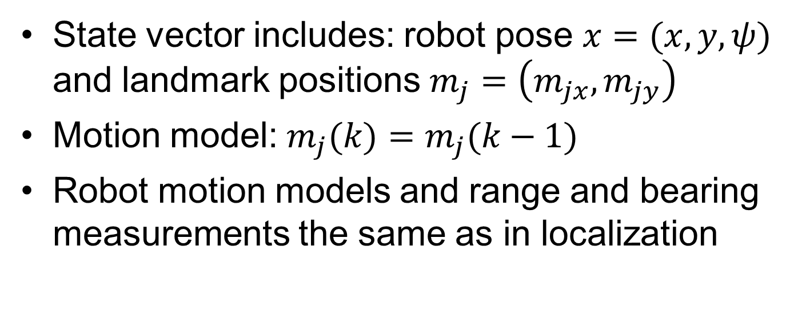
EKF SLAM
State vector includes: robot pose $x=(x,y,ψ)$ and landmark positions $m_{j}=\left(m_{jx},m_{jy}\right)$
Motion model: $m_{j}(k)=m_{j}(k−1)$
Robot motion models and range and bearing measurements the same as in localization

Slide 27
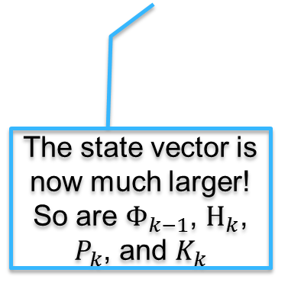
EKF: nonlinear filter 1/3
$x_{k}=φ_{k−1}\left(x_{k−1}\right)+ε_{k−1}$, $ε_{k}\sim 𝒩\left(0,Q_{k}\right)$
$$z_{k}=h_{k}\left(x_{k}\right)+θ_{k}\text{,} θ_{k}\sim 𝒩\left(0,R_{k}\right)$$
Prediction
$${\hat{x}}_{k}\left(−\right)=φ_{k−1}\left(x_{k−1}\left(+\right)\right)$$
$${\hat{z}}_{k}=h_{k}({\hat{x}}_{k}\left(−\right))$$
$$Φ_{k−1}=\frac{∂φ_{k}}{∂x}{\left.​\right|}_{x=x_{k−1}(+)},H_{k}=\frac{∂h_{k}}{∂x}{\left.​\right|}_{x=x_{k}(−)}$$
The state vector is now much larger!
So are $Φ_{k−1}$, $H_{k}$, $P_{k}$, and $K_{k}$

Slide 28
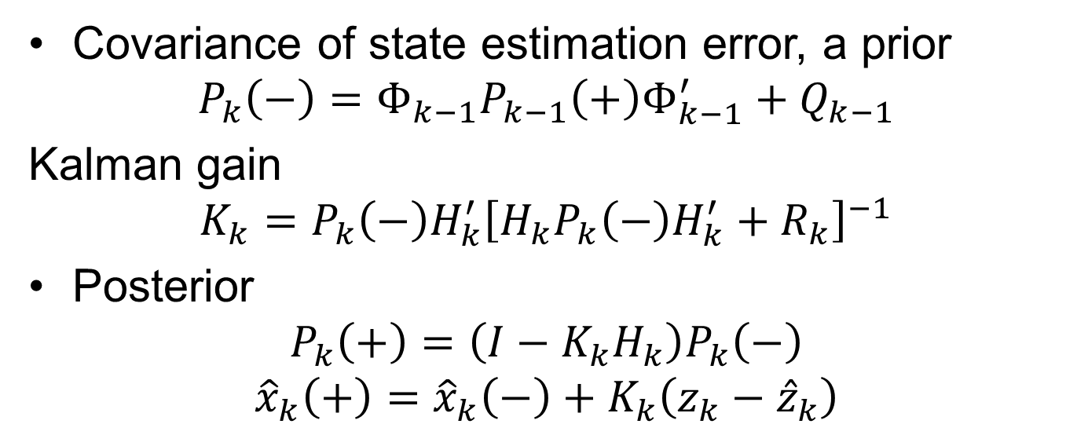
EKF: nonlinear filter 2/3
Covariance of state estimation error, a prior
$$P_{k}\left(−\right)=Φ_{k−1}P_{k−1}\left(+\right)Φ_{k−1}^{′}+Q_{k−1}$$
Kalman gain
$$K_{k}=P_{k}\left(−\right)H_{k}^{′}{\left[H_{k}P_{k}\left(−\right)H_{k}^{′}+R_{k}\right]}^{−1}$$
Posterior
$$P_{k}\left(+\right)=\left(I−K_{k}H_{k}\right)P_{k}\left(−\right)$$
$${\hat{x}}_{k}\left(+\right)={\hat{x}}_{k}\left(−\right)+K_{k}\left(z_{k}−{\hat{z}}_{k}\right)$$

Slide 29
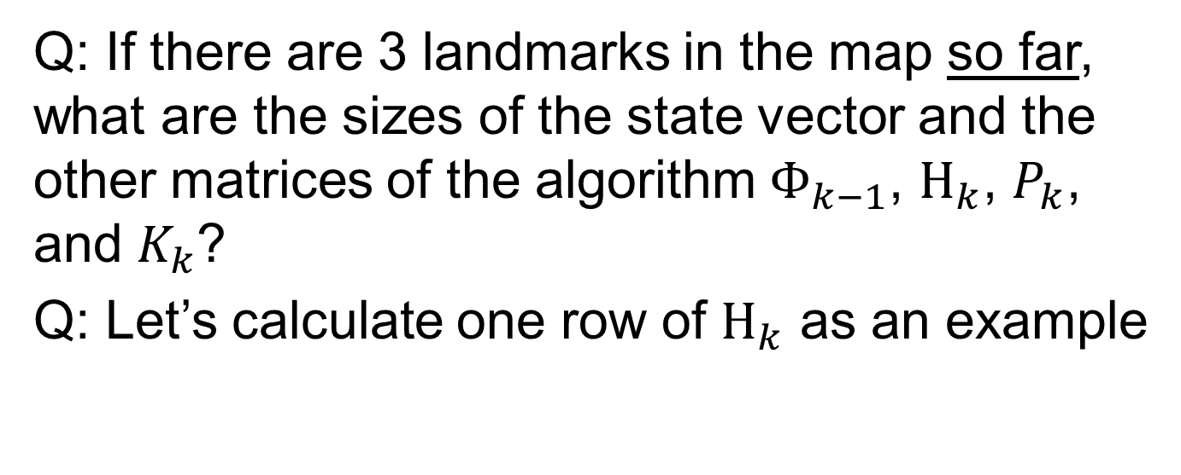
EKF SLAM
Q: If there are 3 landmarks in the map so far, what are the sizes of the state vector and the other matrices of the algorithm $Φ_{k−1}$, $H_{k}$, $P_{k}$, and $K_{k}$?
Q: Let’s calculate one row of $H_{k}$ as an example

Slide 30
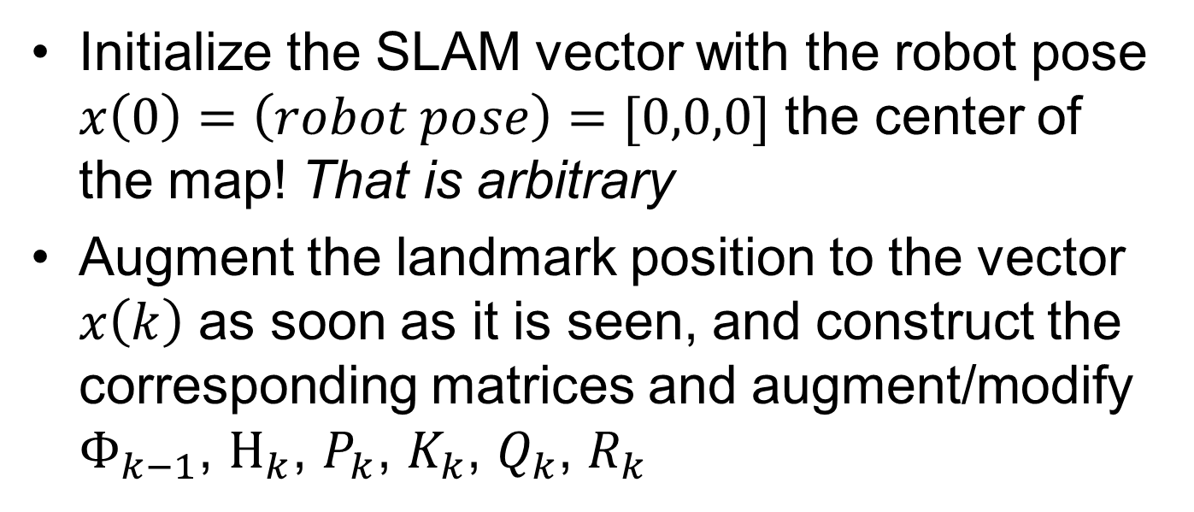
EKF SLAM Algorithm
Initialize the SLAM vector with the robot pose $x\left(0\right)=\left(robot pose\right)=[0,0,0]$ the center of the map! That is arbitrary
Augment the landmark position to the vector $x\left(k\right)$ as soon as it is seen, and construct the corresponding matrices and augment/modify $Φ_{k−1}$, $H_{k}$, $P_{k}$, $K_{k}$, $Q_{k}$, $R_{k}$

Slide 31
Adding new landmark to the map, when the landmarks are not distinguishable
Calculate the innovation for each combination of landmarks (already in the map) and measurements
Check the minimum against an acceptance threshold
If the minimum is above a high threshold, initialize and add the landmark to the map.

Slide 32
Monte Carlo localization
Bayes filter review…

Slide 33
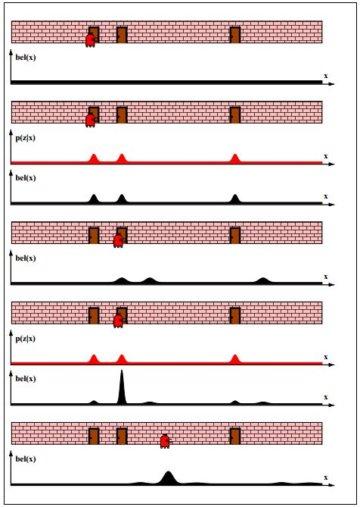
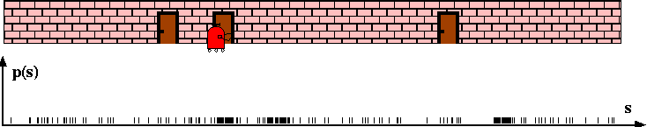
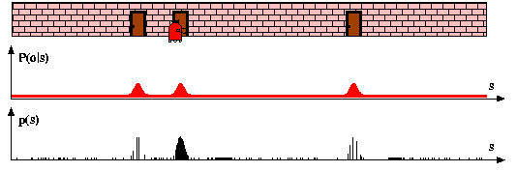
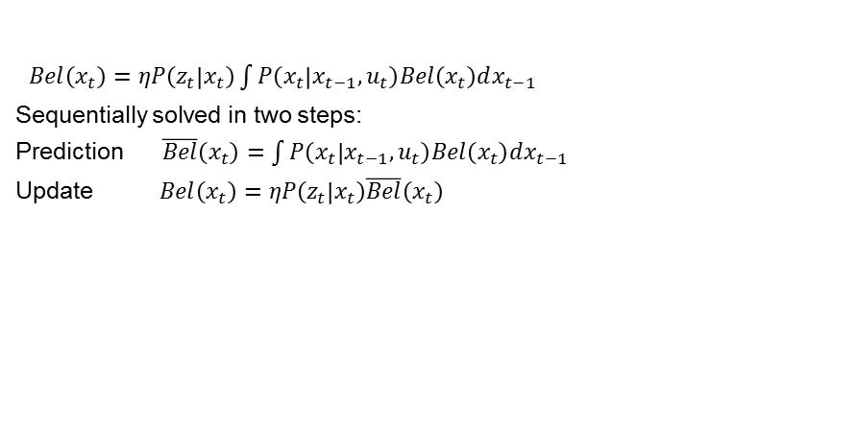
Bayes filter
$Bel\left(x_{t}\right)=ηP\left(z_{t} | x_{t}\right)\int{P\left(x_{t} | x_{t−1},u_{t}\right)Bel\left(x_{t}\right)dx_{t−1} }$
Sequentially solved in two steps:
Prediction $\overline{Bel}\left(x_{t}\right)=\int{P\left(x_{t} | x_{t−1},u_{t}\right)Bel\left(x_{t}\right)dx_{t−1} }$
Update $Bel\left(x_{t}\right)=ηP\left(z_{t} | x_{t}\right)\overline{Bel}\left(x_{t}\right)$
MCL
Notice the difference,
we will come back to this

Slide 34
Distributions representation of belief
Discrete space: Histogram filter
Particles: MC (Monte Carlo) filter
Parametric: (Extended Kalman Filter) EKF

Slide 35
Monte Carlo localization
Based on Monte Carlo sampling
Also called Particle filter localization
Survival of the fittest
Can represent non Gaussian distributions

Slide 36
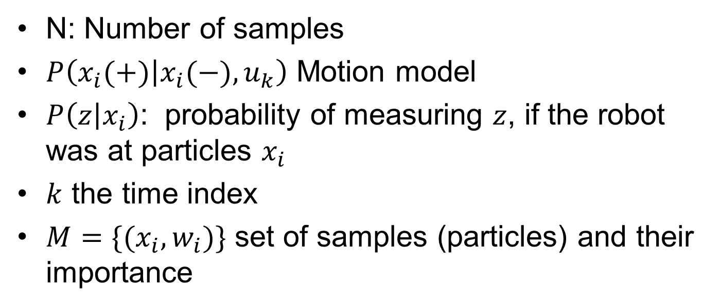
Monte Carlo Localization (MCL), notation
N: Number of samples
$P\left(x_{i}(+) | x_{i}(−),u_{k}\right)$ Motion model
$P\left(z | x_{i}\right)$: probability of measuring $z$, if the robot was at particles $x_{i}$
$k$ the time index
$M=\{(x_{i},w_{i})\}$ set of samples (particles) and their importance

Slide 37
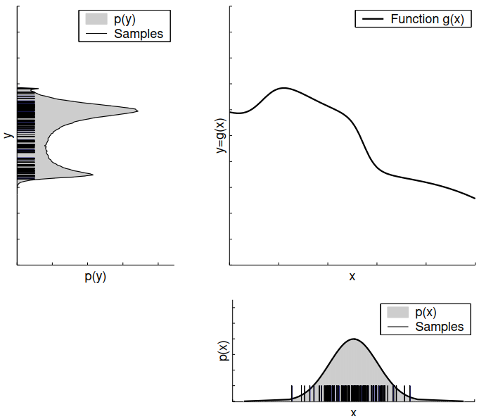
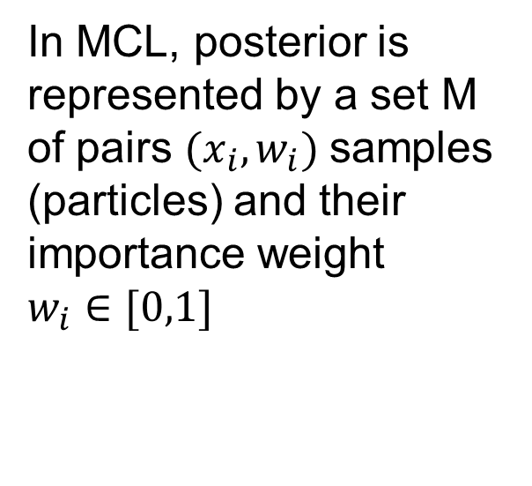
Particles representing distributions
Gaussian is mapped using function g(.) --> Not Gaussian anymore
In MCL, posterior is represented by a set M of pairs $(x_{i},w_{i})$samples (particles) and their importance weight $w_{i}∈[0,1]$

Slide 38
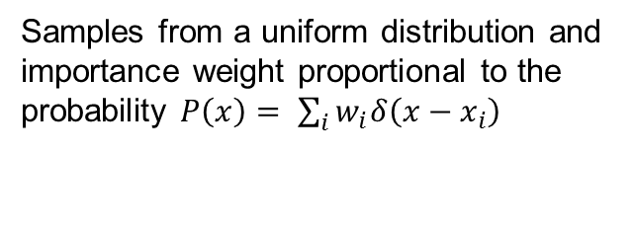
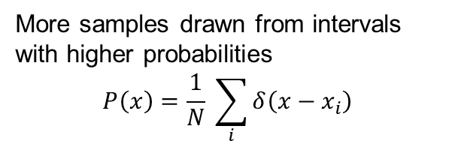
Function approximation
Samples from a uniform distribution and importance weight proportional to the probability $P\left(x\right)= \sum_{i}{w_{i}δ\left(x−x_{i}\right)}$
More samples drawn from intervals with higher probabilities
$$P\left(x\right)=\frac{1}{N} \sum_{i}{δ\left(x−x_{i}\right)}$$
A
B

Slide 39
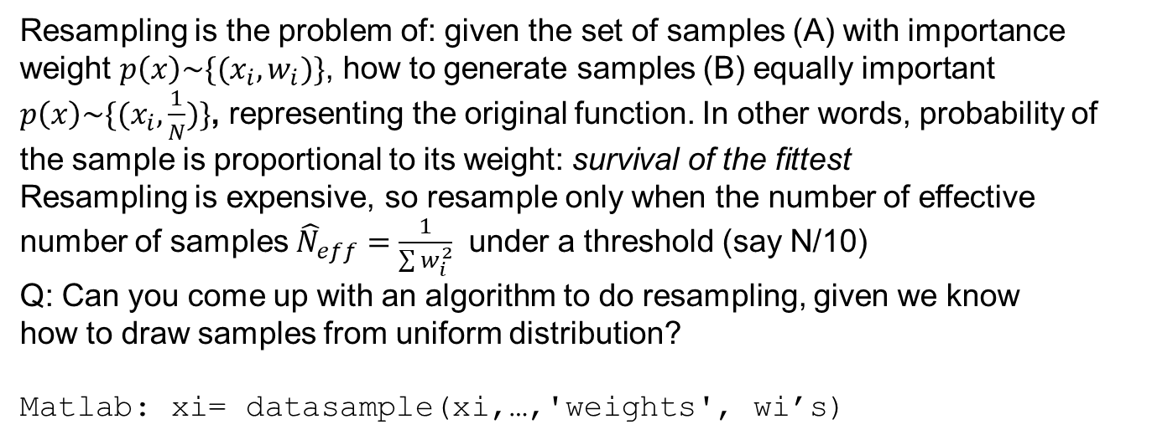
Resampling
Resampling is the problem of: given the set of samples (A) with importance
weight $p\left(x\right)\sim \{(x_{i},w_{i})\}$, how to generate samples (B) equally important
$p\left(x\right)\sim \{(x_{i},\frac{1}{N})\}$, representing the original function. In other words, probability of
the sample is proportional to its weight: survival of the fittest
Resampling is expensive, so resample only when the number of effective
number of samples ${\hat{N}}_{eff}=\frac{1}{\sum{w_{i}^{2}}}$ under a threshold (say N/10)
Q: Can you come up with an algorithm to do resampling, given we know
how to draw samples from uniform distribution?
Matlab: xi= datasample(xi,…,'weights', wi’s)

Slide 40
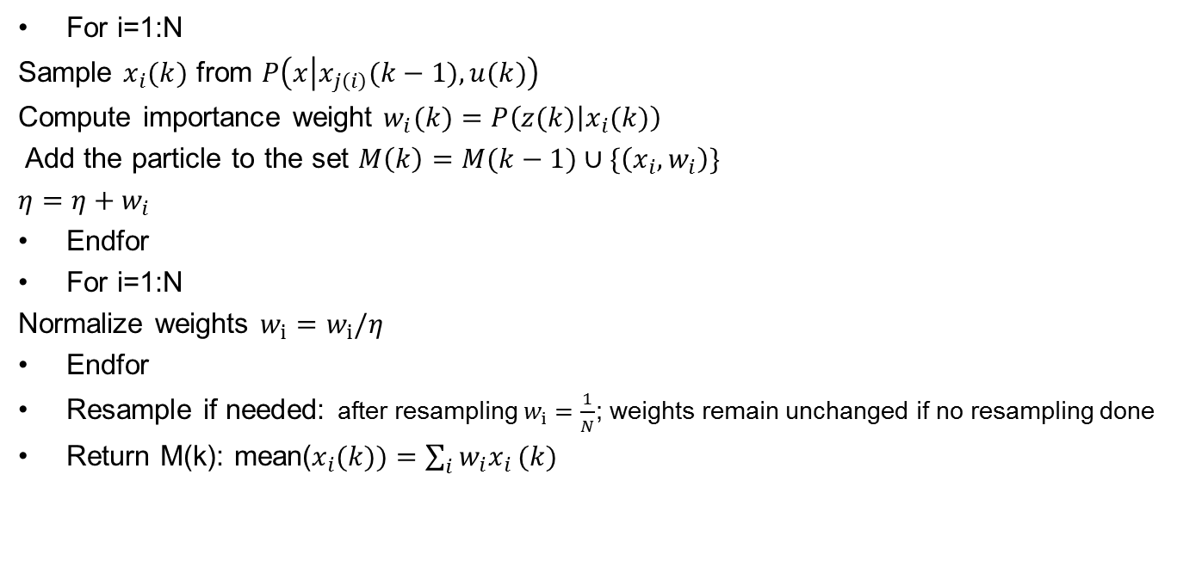
MCL, algorithm at time k also called bootstrap filter
For i=1:N
Sample $x_{i}(k)$ from $P\left(x | x_{j\left(i\right)}(k−1),u(k)\right)$
Compute importance weight $w_{i}(k)=P\left(z(k) | x_{i}(k)\right)$
Add the particle to the set $M\left(k\right)=M(k−1)∪\{\left(x_{i},w_{i}\right)\}$
$η=η+w_{i}$
Endfor
For i=1:N
Normalize weights $w_{i}=w_{i}/η$
Endfor
Resample if needed: after resampling $w_{i}=\frac{1}{N}$; weights remain unchanged if no resampling done
Return M(k): mean($x_{i}(k))=\sum_{i}{w_{i}x_{i}}(k)$
Three main parts
Sample from motion model
Calculate the importance weight
Resample

Slide 41
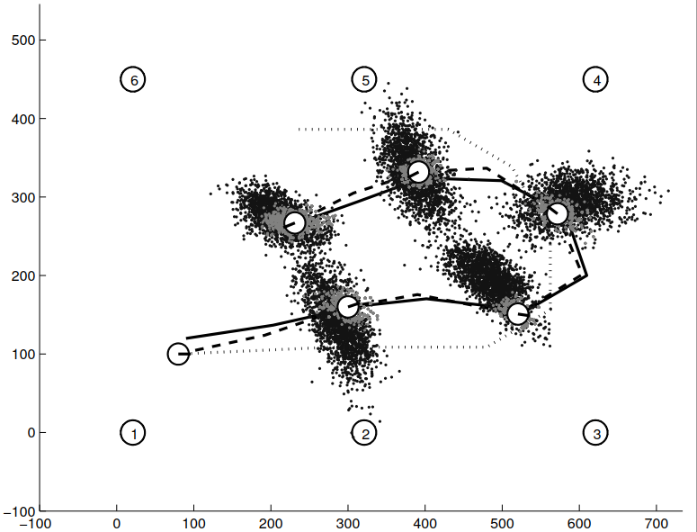
MCL
Map ={1,…,6}
Resampling:
Ensures that the particles survive only in meaningful parts of the state space (where the weights are not negligible)

Slide 42
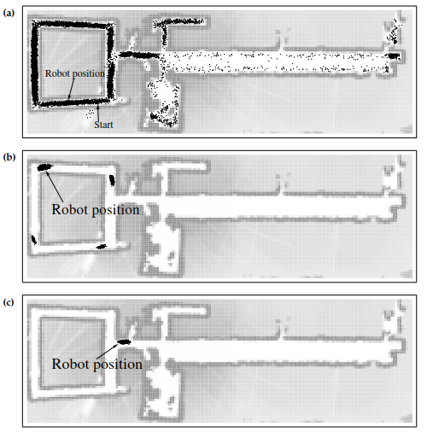
MCL capable of global localization
in contract to EKF
It also does pose tracking

Slide 43
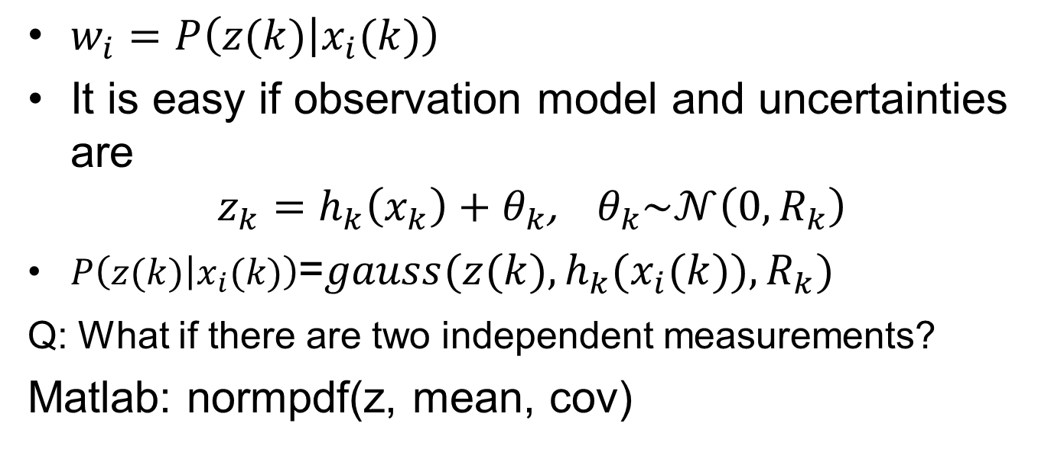
Importance weights
Three main parts
Sample from motion model
Calculate the importance weight
Resample
$w_{i}=P\left(z(k) | x_{i}(k)\right)$
It is easy if observation model and uncertainties are
$$z_{k}=h_{k}\left(x_{k}\right)+θ_{k}\text{,} θ_{k}\sim 𝒩\left(0,R_{k}\right)$$
$P\left(z(k) | x_{i}(k)\right)$=$gauss(z(k),h_{k}(x_{i}(k)),R_{k})$
Q: What if there are two independent measurements?
Matlab: normpdf(z, mean, cov)

Slide 44
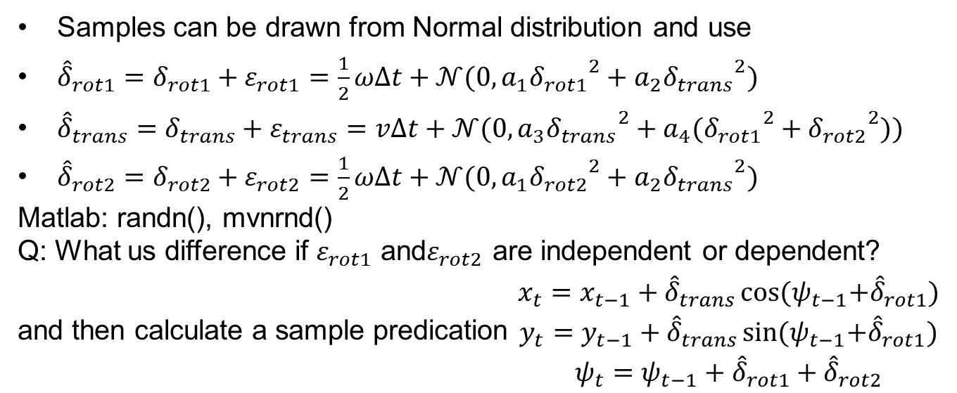
Sampling motion model 1/2
Samples can be drawn from Normal distribution and use
${\hat{δ}}_{rot1}=δ_{rot1}+ε_{rot1}=\frac{1}{2}ωΔt+𝒩(0,a_{1}{δ_{rot1}}^{2}+a_{2}{δ_{trans}}^{2})$
${\hat{δ}}_{trans}=δ_{trans}+ε_{trans}=vΔt+𝒩(0,a_{3}{δ_{trans}}^{2}+a_{4}({δ_{rot1}}^{2}+{δ_{rot2}}^{2}))$
${\hat{δ}}_{rot2}=δ_{rot2}+ε_{rot2}=\frac{1}{2}ωΔt+𝒩(0,a_{1}{δ_{rot2}}^{2}+a_{2}{δ_{trans}}^{2})$
Matlab: randn(), mvnrnd()
Q: What us difference if $ε_{rot1}$ and$ε_{rot2}$ are independent or dependent?
and then calculate a sample predication $\begin{matrix}x_{t}=x_{t−1}+{\hat{δ}}_{trans}\cos{{(ψ}_{t−1}+{\hat{δ}}_{rot1})} \\ y_{t}=y_{t−1}+{\hat{δ}}_{trans}\sin{{(ψ}_{t−1}+{\hat{δ}}_{rot1})} \\ ψ_{t}=ψ_{t−1}+{\hat{δ}}_{rot1}+{\hat{δ}}_{rot2}\end{matrix}$

Slide 45
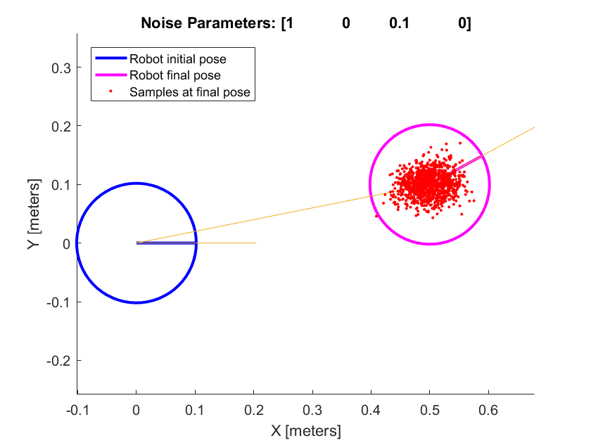
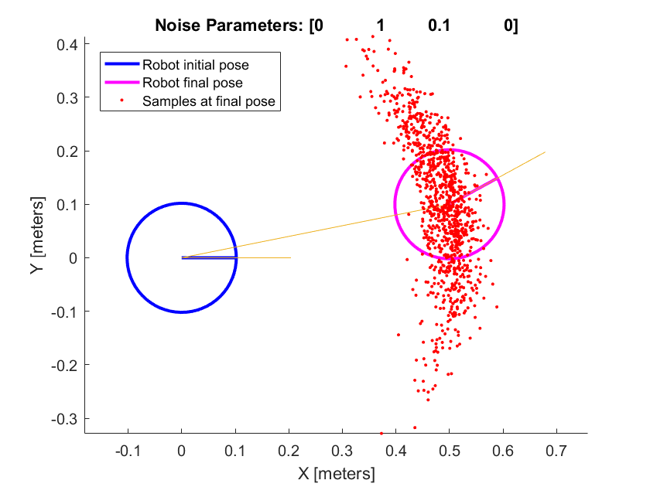
Sampling motion model 2/2
robotics.OdometryMotionModel class; Gaussian noise 4-element vector
Rotational error due to rotational motion
Rotational error due to translational motion
Translational error due to translation motion
Translational error due to rotational motion

Slide 46
Conditioning on the obstacle map
How to tell the filter that is impossible that the robot is inside a wall?
First sample motion model without map
Accept only samples that lie in free space
This improves sampling but ignores the case that some sample may pass through the obstacles, if odometry translations are large

Slide 47
Mont Carlo Localization
http://robots.stanford.edu/movies/sca80a0.avi using Laser range finder
http://robots.stanford.edu/movies/Sampling2.avi Ceiling maps

Slide 48
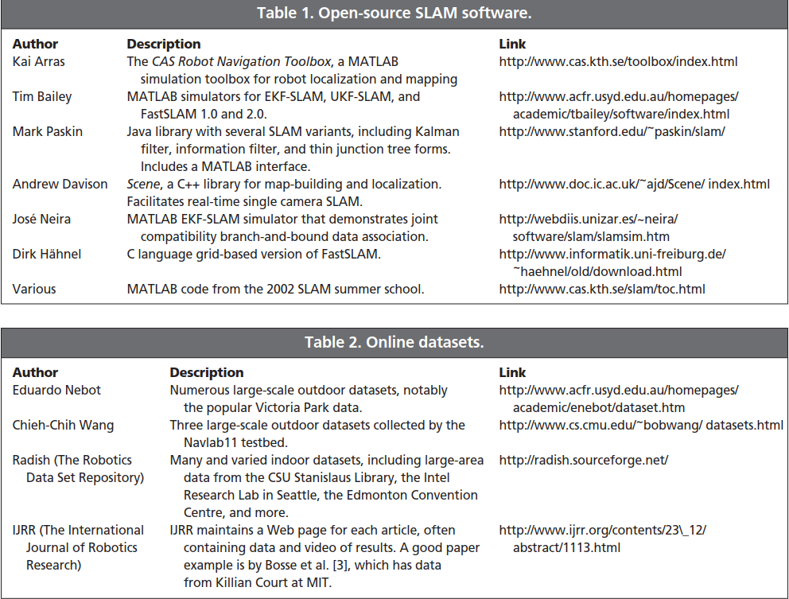
Tutorial on Simultaneous Localization and Mapping: Part I and II, 2006
HUGH DURRANT-WHYTE AND TIM BAILEY

Slide 49
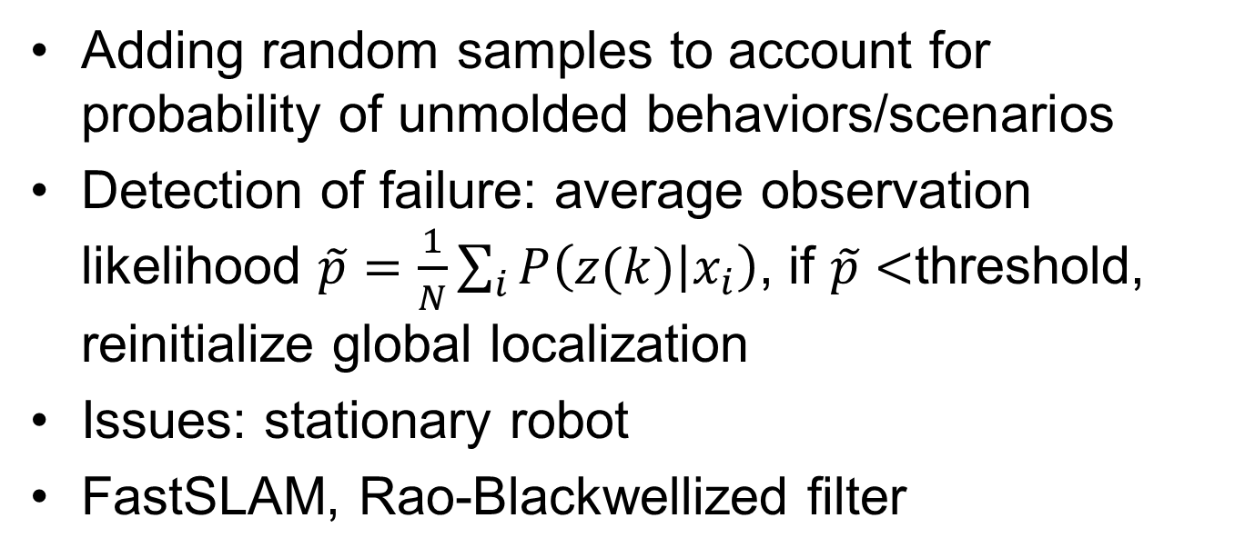
Other topics
Adding random samples to account for probability of unmolded behaviors/scenarios
Detection of failure: average observation likelihood $\tilde{p}=\frac{1}{N}\sum_{i}{P\left(z(k) | x_{i}\right)}$, if $\tilde{p}<$threshold, reinitialize global localization
Issues: stationary robot
FastSLAM, Rao-Blackwellized filter

Slide 50
FastSLAM, Rao-Blackwellized filter
Essence:
motion model represented by Monte Carlo sampling and
Observation (bearing, range) is linearized
benefiting from both EKF and MCL

Slide 51
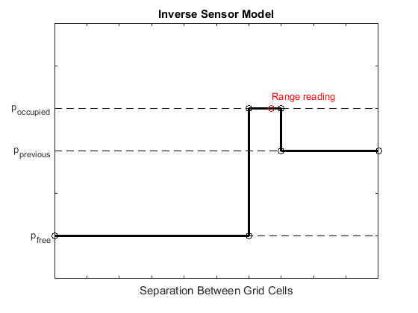
Mapping with known pose
Given a point observation (reflection from the environment), how to build a probabilistic map: a grid map, which each of its cell are probability of being occupied.
See Matlab function:
insertRay (.) from
Class: robotics.OccupancyGrid
Model of one ray

